Slide 1
JAVA Programming Language LESSON 16: GUI Components, AWT and Swing
KANIMBA Patrick
IPRC SOUTH
ICT Department

Slide 2
Outline
GUI Introduction
Overview of AWT(abstract window toolkit)
Overview of Swing
The basic UI components

Slide 3
GUI introduction

Slide 4
GUI Introduction
A graphical user interface (GUI) presents a pictorial interface to a program.
Providing different programs with a consistent set of intuitive user interface components provides users with a basic level of familiarity with each program before they ever use it.
In turn, this reduces the time users require to learn a program and increases their ability to use the program in a productive manner.

Slide 5
GUI Introduction
Graphical User Interface (GUI)
Gives program distinctive “look” and “feel”
Provides users with basic level of familiarity
Built from GUI components (controls, widgets, etc.)
User interacts with GUI component via mouse, keyboard, etc.

Slide 6
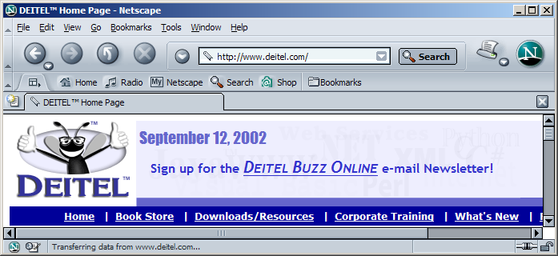
Netscape window with GUI components
button
menus
menu bar
combo box
scroll bars

Slide 7
The basic idea of AWT
The basic idea behind the AWT is that a Java window is a set of nested components, starting from the outermost window all the way down to the smallest UI component.
Components can include things you can actually see on the screen, such as windows, menubars, buttons, and text fields, and they can also include containers, which in turn can contain other components.

Slide 8
The major components of AWT
Containers
Canvases
UI components
Window construction components

Slide 9
Containers
Containers are generic AWT components that can contain other components, including other containers.
The most common form of container is the panel, which represents a container that can be displayed on screen.

Slide 10
Canvases
A canvas is a simple drawing surface.
Canvases are good for painting images or other graphics operations.

Slide 11
UI components
Include typical elements of a user interface, for examples:
buttons
lists
checkboxes
popup menus
text fields
…

Slide 12
Window construction components
windows
frames
menubars
dialogs

Slide 13
The basic UI components
Frame
Button
List
Label

Slide 14
The eight core packages of Java
java.awt
java.awt.event
java.io
java.sql
java.net
java.util
java.lang
java.applet

Slide 15
Overview of Swing Components
Swing GUI components
Package javax.swing
Components originate from AWT (package java.awt)
Contain look and feel
Appearance and how users interact with program
Lightweight components
Written completely in Java

Slide 16
Overview of Swing Components
Class Component
Contains method paint for drawing Component onscreen
Class Container
Collection of related components
Contains method add for adding components
Class JComponent
Pluggable look and feel for customizing look and feel
Shortcut keys (mnemonics)
Common event-handling capabilities

Slide 17
Common superclasses of many of the Swing components
Object
Object
Component
Component
Container
Container
JComponent
JComponent

Slide 18
Some basic GUI components
Component | Description
JLabel | An area where uneditable text or icons can be displayed.
JTextField | An area in which the user inputs data from the keyboard. The area can also display information.
JButton | An area that triggers an event when clicked with the mouse.
JCheckBox | A GUI component that is either selected or not selected.
JComboBox | A drop-down list of items from which the user can make a selection by clicking an item in the list or possibly by typing into the box.
JList | An area containing a list of items from which the user can make a selection by clicking on any element in the list. Multiple elements can be selected.
JPanel | A container in which components can be placed and organized.

Slide 19
Swing Component: JLabel
Label
Provide text on GUI
Defined with class JLabel
Can display:
Single line of read-only text
Image
Text and image

Slide 20
Sample code – LabelTest.java
1 // Sample code: LabelTest.java 2 // Demonstrating the JLabel class. 3 import java.awt.*; 4 import java.awt.event.*; 5 import javax.swing.*; 6 7 public class LabelTest extends JFrame { 8 private JLabel label1, label2, label3; 9 10 // set up GUI 11 public LabelTest() 12 { 13 super( "Testing JLabel" ); 14 15 // get content pane and set its layout 16 Container container = getContentPane(); 17 container.setLayout( new FlowLayout() ); 18 19 // JLabel constructor with a string argument 20 label1 = new JLabel( "Label with text" ); 21 label1.setToolTipText( "This is label1" ); 22 container.add( label1 ); 23
Declare three JLabels
Create first JLabel with text “Label with text”
Tool tip is text that appears when user moves cursor over JLabel

Slide 21
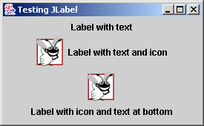
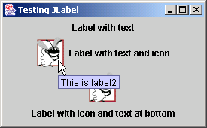
Sample code – LabelTest.java
24 // JLabel constructor with string, Icon and alignment arguments 25 Icon bug = new ImageIcon( "bug1.gif" ); 26 label2 = new JLabel( "Label with text and icon", bug, 27 SwingConstants.LEFT ); 28 label2.setToolTipText( "This is label2" ); 29 container.add( label2 ); 30 31 // JLabel constructor no arguments 32 label3 = new JLabel(); 33 label3.setText( "Label with icon and text at bottom" ); 34 label3.setIcon( bug ); 35 label3.setHorizontalTextPosition( SwingConstants.CENTER ); 36 label3.setVerticalTextPosition( SwingConstants.BOTTOM ); 37 label3.setToolTipText( "This is label3" ); 38 container.add( label3 ); 39 40 setSize( 275, 170 ); 41 setVisible( true ); 42 43 } // end constructor 44 45 public static void main( String args[] ) 46 { 47 LabelTest application = new LabelTest(); 48 application.setDefaultCloseOperation( JFrame.EXIT_ON_CLOSE ); 49 } 50 51 } // end class LabelTest
Create second JLabel with text to left of image
Create third JLabel with text below image

Slide 22
Event Handling
GUIs are event driven
Generate events when user interacts with GUI
e.g., moving mouse, pressing button, typing in text field, etc.
Class java.awt.AWTEvent

Slide 23
Some event classes of package java.awt.event
Object
Object
ActionEvent
EventObject
ActionEvent
EventObject
AdjustmentEvent
AWTEvent
AdjustmentEvent
ContainerEvent
AWTEvent
ItemEvent
ContainerEvent
ItemEvent
FocusEvent
TextEvent
FocusEvent
TextEvent
PaintEvent
ComponentEvent
PaintEvent
ComponentEvent
WindowEvent
WindowEvent
InputEvent
InputEvent
KeyEvent
MouseEvent
KeyEvent
MouseEvent
MouseWheelEvent
MouseWheelEvent

Slide 24
Swing Event Handling
Event-handling model
Three parts
Event source
GUI component with which user interacts
Event object
Encapsulates information about event that occurred
Event listener
Receives event object when notified, then responds
Programmer must perform two tasks
Register event listener for event source
Implement event-handling method (event handler)

Slide 25
Event-listener interfaces of package java.awt.event
«interface» ActionListener
interface
ActionListener
«interface» AdjustmentListener
interface
AdjustmentListener
«interface» ComponentListener
interface
ComponentListener
«interface» ContainerListener
interface
ContainerListener
«interface» FocusListener
interface
FocusListener
«interface» EventListener
«interface» ItemListener
interface
EventListener
interface
ItemListener
«interface» KeyListener
interface
KeyListener
«interface» MouseListener
interface
MouseListener
«interface» MouseMotionListener
interface
MouseMotionListener
«interface» TextListener
interface
TextListener
«interface» TextListener
interface
WindowListener

Slide 26
Swing Component: JTextFields
JTextField
Single-line area in which user can enter text
JPasswordField
Extends JTextField
Hides characters that user enters

Slide 27
Sample code – TextFieldTest.java
1 // Sample code: TextFieldTest.java 2 // Demonstrating the JTextField class. 3 import java.awt.*; 4 import java.awt.event.*; 5 import javax.swing.*; 6 7 public class TextFieldTest extends JFrame { 8 private JTextField textField1, textField2, textField3; 9 private JPasswordField passwordField; 10 11 // set up GUI 12 public TextFieldTest() 13 { 14 super( "Testing JTextField and JPasswordField" ); 15 16 Container container = getContentPane(); 17 container.setLayout( new FlowLayout() ); 18 19 // construct textfield with default sizing 20 textField1 = new JTextField( 10 ); 21 container.add( textField1 ); 22 23 // construct textfield with default text 24 textField2 = new JTextField( "Enter text here" ); 25 container.add( textField2 ); 26
Declare three JTextFields and one JPasswordField
First JTextField contains empty string
Second JTextField contains text “Enter text here”

Slide 28
Sample code – TextFieldTest.java
27 // construct textfield with default text, 28 // 20 visible elements and no event handler 29 textField3 = new JTextField( "Uneditable text field", 20 ); 30 textField3.setEditable( false ); 31 container.add( textField3 ); 32 33 // construct passwordfield with default text 34 passwordField = new JPasswordField( "Hidden text" ); 35 container.add( passwordField ); 36 37 // register event handlers 38 TextFieldHandler handler = new TextFieldHandler(); 39 textField1.addActionListener( handler ); 40 textField2.addActionListener( handler ); 41 textField3.addActionListener( handler ); 42 passwordField.addActionListener( handler ); 43 44 setSize( 325, 100 ); 45 setVisible( true ); 46 47 } // end constructor TextFieldTest 48 49 public static void main( String args[] ) 50 { 51 TextFieldTest application = new TextFieldTest(); 52 application.setDefaultCloseOperation( JFrame.EXIT_ON_CLOSE ); 53 }
Third JTextField contains uneditable text
JPasswordField contains text “Hidden text,” but text appears as series of asterisks (*)
Register GUI components with TextFieldHandler
(register for ActionEvents)

Slide 29
Sample code – TextFieldTest.java
55 // private inner class for event handling 56 private class TextFieldHandler implements ActionListener { 57 58 // process textfield events 59 public void actionPerformed( ActionEvent event ) 60 { 61 String string = ""; 62 63 // user pressed Enter in JTextField textField1 64 if ( event.getSource() == textField1 ) 65 string = "textField1: " + event.getActionCommand(); 66 67 // user pressed Enter in JTextField textField2 68 else if ( event.getSource() == textField2 ) 69 string = "textField2: " + event.getActionCommand(); 70 71 // user pressed Enter in JTextField textField3 72 else if ( event.getSource() == textField3 ) 73 string = "textField3: " + event.getActionCommand(); 74 75 // user pressed Enter in JTextField passwordField 76 else if ( event.getSource() == passwordField ) { 77 string = "passwordField: " + 78 new String( passwordField.getPassword() ); 79 }
Every TextFieldHandler instance is an ActionListener
Method actionPerformed invoked when user presses Enter in GUI field

Slide 30
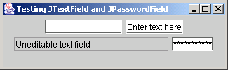
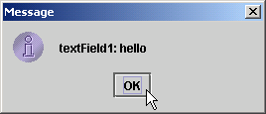
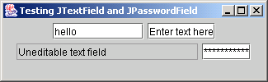
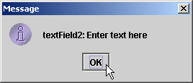
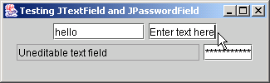
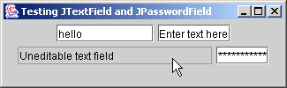
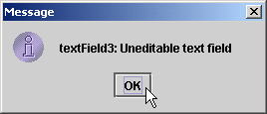
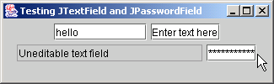
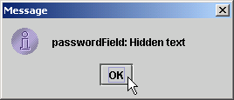
Sample code – TextFieldTest.java
80 81 JOptionPane.showMessageDialog( null, string ); 82 83 } // end method actionPerformed 84 85 } // end private inner class TextFieldHandler 86 87 } // end class TextFieldTest

Slide 31
How Event Handling Works
Two open questions from the previous slides
How did event handler get registered?
Answer:
Through component’s method addActionListener
Lines 39-42 of TextFieldTest.java
How does component know to call actionPerformed?
Answer:
Event is dispatched only to listeners of appropriate type
Each event type has corresponding event-listener interface
Event ID specifies event type that occurred

Slide 32
Event registration for JTextField textField1
textField1
handler
listenerList
public void actionPerformed( ActionEvent event ) {
// event handled here
}
JTextField object
TextFieldHandler object
...
This reference is created by the statement
textField1.addActionListener( handler );

Slide 33
Swing component: JButton
Button
Component user clicks to trigger a specific action
Several different types
Command buttons
Check boxes
Toggle buttons
Radio buttons
javax.swing.AbstractButton subclasses
Command buttons are created with class JButton
Generate ActionEvents when user clicks button

Slide 34
Swing button hierarchy
JComponent
JComponent
AbstractButton
AbstractButton
JButton
JToggleButton
JButton
JToggleButton
JCheckBox
JRadioButton
JCheckBox
JRadioButton

Slide 35
Sample code – ButtonTest.java
1 // Sample code: ButtonTest.java 2 // Creating JButtons. 3 import java.awt.*; 4 import java.awt.event.*; 5 import javax.swing.*; 6 7 public class ButtonTest extends JFrame { 8 private JButton plainButton, fancyButton; 9 10 // set up GUI 11 public ButtonTest() 12 { 13 super( "Testing Buttons" ); 14 15 // get content pane and set its layout 16 Container container = getContentPane(); 17 container.setLayout( new FlowLayout() ); 18 19 // create buttons 20 plainButton = new JButton( "Plain Button" ); 21 container.add( plainButton ); 22 23 Icon bug1 = new ImageIcon( "bug1.gif" ); 24 Icon bug2 = new ImageIcon( "bug2.gif" ); 25 fancyButton = new JButton( "Fancy Button", bug1 ); 26 fancyButton.setRolloverIcon( bug2 ); 27 container.add( fancyButton );
Create two references to JButton instances
Instantiate JButton with text
Instantiate JButton with image and rollover image

Slide 36
Sample code – ButtonTest.java
28 29 // create an instance of inner class ButtonHandler 30 // to use for button event handling 31 ButtonHandler handler = new ButtonHandler(); 32 fancyButton.addActionListener( handler ); 33 plainButton.addActionListener( handler ); 34 35 setSize( 275, 100 ); 36 setVisible( true ); 37 38 } // end ButtonTest constructor 39 40 public static void main( String args[] ) 41 { 42 ButtonTest application = new ButtonTest(); 43 application.setDefaultCloseOperation( JFrame.EXIT_ON_CLOSE ); 44 } 45 46 // inner class for button event handling 47 private class ButtonHandler implements ActionListener { 48 49 // handle button event 50 public void actionPerformed( ActionEvent event ) 51 { 52 JOptionPane.showMessageDialog( ButtonTest.this, 53 "You pressed: " + event.getActionCommand() ); 54 }
Instantiate ButtonHandler for JButton event handling
Register JButtons to receive events from ButtonHandler
When user clicks JButton, ButtonHandler invokes method actionPerformed of all registered listeners

Slide 37
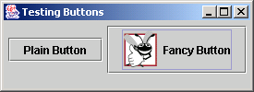
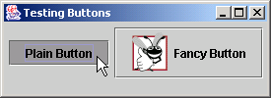
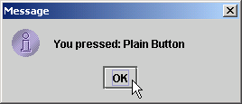
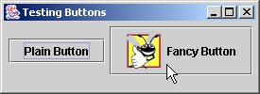
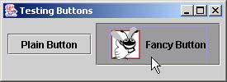
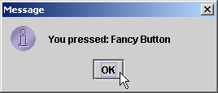
Sample code – ButtonTest.java
55 56 } // end private inner class ButtonHandler 57 58 } // end class ButtonTest

Slide 38
ButtonTest.java
55
56 } // end private inner class ButtonHandler
57
58 } // end class ButtonTest

Slide 39
Swing Component: JCheckBox and JRadioButton
State buttons
On/Off or true/false values
Java provides three types
JToggleButton
JCheckBox
JRadioButton

Slide 40
Thanks

